Slide 1

NT101-Network Security
Week 06 Data link layer security
Ngoc-Tu Nguyen, PhD
tunn@uit.edu.vn

Slide 2
Outline
Motivations
Data link layer (review)
ARP protocol (review)
Routing security
ARP protocol
ARP attack

Slide 3











Motivations
source
application
message
M
Secure Routing
Seccure hop-by-hop
segment
H_{t}
M
transport network
H_{t}
datagram
H_{n} H_{t}
M
H_{n}
Intermediary devices
frame
H_{l}
H_{n} H_{t} M
link physical
next hop?
H_{l} | H_{n} | H_{t} | M
link physical
switch
next hop?
MAC?
destination
H_{n} | H_{t} | M
network
IP router
M
application
transport
network
link
physical
H_{l} | H_{n} | H_{t} | M
link physical
H_{n}
H_{t}
M
next hop?
H_{t}
M
Routing!
 | H_{n} | H_{t} | M
H_{l} | H_{n} | H_{t} | M

Slide 4



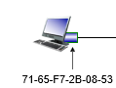
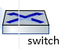
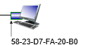
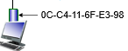
Motivations
Network card
Secure Routing
Seccure hop-by-hop
1A-2F-BB-76-09-AD
H_{l} | H_{n} | H_{t} | M
Nect hop?
H’_{l} | H_{n} | H_{t} | M

Slide 5
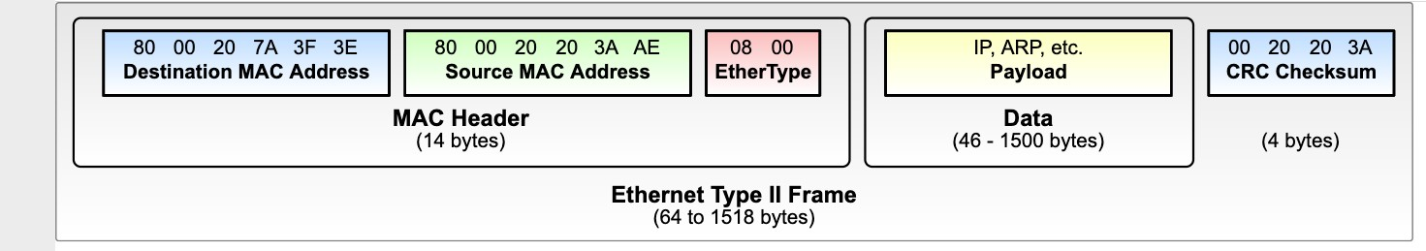
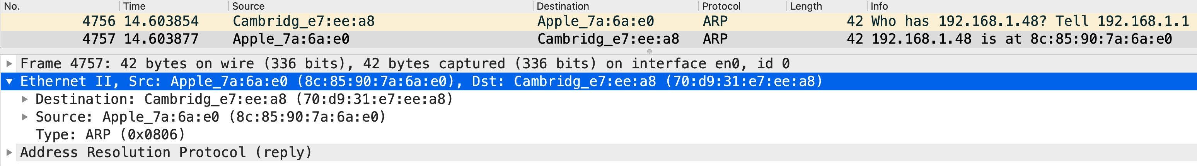
Motivations: Ethernet frame and MAC header
IEEE 802.3
H_{l}
16

Slide 6
Media Access Control (MAC) addresses
MAC (or LAN or physical or Ethernet) address:
function: used “locally” to get frame from one interface to another physically-connected interface (same subnet, in IP-addressing sense)
48-bit MAC address (for most LANs) burned in NIC ROM, also sometimes software settable
e.g.: 1A-2F-BB-76-09-AD
hexadecimal (base 16) notation (each “numeral” represents 4 bits)

Slide 7

Outline
The Data link layer
A revew
NT101 – Network Security

Slide 8















Interfaces communicating
Recall
application
application
transport
network
link
transport
cpu
memory
memory
CPU
datagra
m
network
link
controller
controller
link_{h}
datagram
datagram
link_{h}
link
link
physical
physical
physical
physical
sending side:
encapsulates datagram in frame
adds error checking bits, reliable data transfer, flow control, etc.
receiving side:
looks for errors, reliable data transfer, flow control, etc.
extracts datagram, passes to upper layer at receiving side

Slide 9
MAC addresses
32-bit IP address:
network-layer address for interface
used for layer 3 (network layer) forwarding
e.g.: 128.119.40.136
MAC (or LAN or physical or Ethernet) address:
function: used “locally” to get frame from one interface to another physically-connected interface (same subnet, in IP-addressing sense)
48-bit MAC address (for most LANs) burned in NIC ROM, also sometimes software settable
e.g.: 1A-2F-BB-76-09-AD
hexadecimal (base 16) notation (each “numeral” represents 4 bits)

Slide 10






MAC addresses
each interface on LAN
has unique 48-bit MAC address
has a locally unique 32-bit IP address (as we’ve seen)
137.196.7.78
1A-2F-BB-76-09-AD
LAN
(wired or wireless)
137.196.7/24
71-65-F7-2B-08-53
137.196.7.23
58-23-D7-FA-20-B0
137.196.7.14
0C-C4-11-6F-E3-98
137.196.7.88

Slide 11
MAC addresses
MAC address allocation administered by IEEE
manufacturer buys portion of MAC address space (to assure uniqueness)
analogy:
MAC address: like Social Security Number
IP address: like postal address
MAC flat address: portability
can move interface from one LAN to another
recall IP address not portable: depends on IP subnet to which node is attached

Slide 12
Ethernet frame and MAC header
IEEE 802.3
16

Slide 13
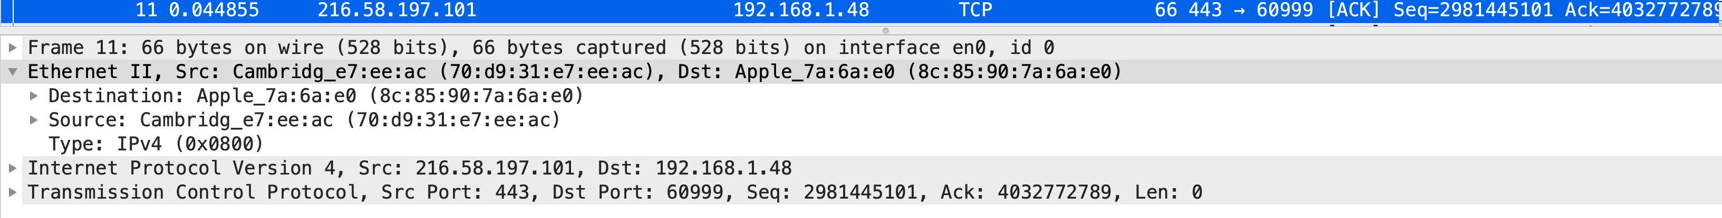
Ethernet frame example
Using Wireshark
Type:
- 0x0806: ARP
- 0x0800: IPv4

Slide 14
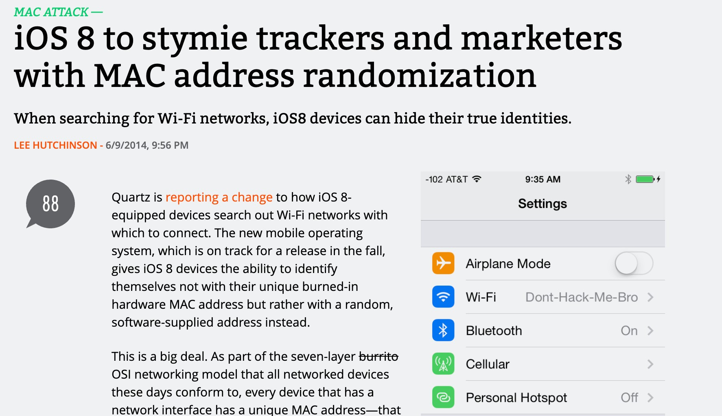

Privacy issue related to MAC
MAC privacy
The MAC address is unique
E.g. When you wall around a Mall
When you talk to a WiFi access point (AP)
= tell your MAC address
→ APs can remember your MAC
→ They can trace where you have been
Solution: Try to probe Aps = using software-generated MAC address
The Trade-off:
PERFORMANCE vs. PRIVACY
https://arstechnica.com/gadgets/2014/06/ios8-to-stymie-trackers-and-marketers-with-mac-address-randomization/
Notes:
Stymie = prevent

Slide 15
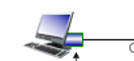

Outline
The ARP Protocol
A review
NT101 – Network Security
LAN network
What is your MAC?
130.29.7.100
130.29.7.1

Slide 16
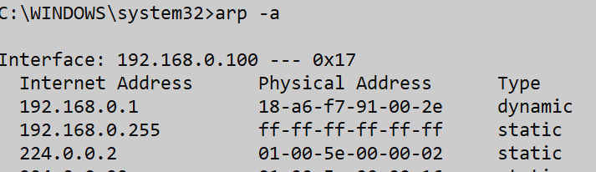








ARP: address resolution protocol
Question: how to determine interface’s MAC address, knowing its IP address?
ARP
ARP table (cache): each IP node (host, router) on LAN has table
IP/MAC address mappings for some LAN nodes:
< IP address; MAC address; TTL>
TTL (Time To Live): time after which address mapping will be forgotten (typically 20 min)
137.196.7.78
1A-2F-BB-76-09-AD
ARP
ARP
LAN
71-65-F7-2B-08-53
137.196.7.23
58-23-D7-FA-20-B0
137.196.7.14
ARP
0C-C4-11-6F-E3-98
137.196.7.88

Slide 17










ARP protocol in action
Example: A wants to send datagram to B
Bʼs MAC address not in A’s ARP table, so A uses ARP to find B’s MAC address
A broadcasts ARP query, containing B's IP addr
destination MAC address = FF-FF-FF-FF-FF-FF
all nodes on LAN receive ARP query
1
Ethernet frame (sent to FF-FF-FF-FF-FF-FF)
C
Source MAC: 71-65-F7-2B-08-53
Source IP: 137.196.7.23
Target IP address: 137.196.7.14
…
ARP table in A
IP addr | MAC addr | TTL
TTL
A
B
1
71-65-F7-2B-08-53
137.196.7.23
58-23-D7-FA-20-B0
137.196.7.14
D

Slide 18



ARP protocol in action
example: A wants to send datagram to B
Bʼs MAC address not in A’s ARP table, so A uses ARP to find B’s MAC address
ARP message into Ethernet frame (sent to 71-65-F7-2B-08-53)
C
Target IP address: 137.196.7.14
Target MAC address:
58-23-D7-FA-20-B0
…
ARP table in A
IP addr | MAC addr | TTL
TTL
A
B
2
71-65-F7-2B-08-53
137.196.7.23
58-23-D7-FA-20-B0
137.196.7.14
2
B replies to A with ARP response, giving its MAC address
D

Slide 19



ARP protocol in action
example: A wants to send datagram to B
Bʼs MAC address not in A’s ARP table, so A uses ARP to find B’s MAC address
C
ARP table in A
IP addr | MAC addr | TTL
137.196. 7.14 | 58-23-D7-FA-20-B0 | 500
TTL
A
B
71-65-F7-2B-08-53
137.196.7.23
58-23-D7-FA-20-B0
137.196.7.14
A receives B’s reply, adds B entry into its local ARP table
3
D

Slide 20
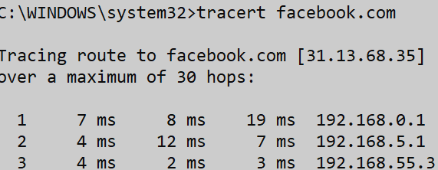






Routing to another subnet: addressing
Walkthrough: sending a datagram from A to B via R
focus on addressing – at IP (datagram) and MAC layer (frame) levels
assume that:
A knows B’s IP address
A knows IP address of first hop router, R (how?)
A knows R’s MAC address (how?)
A
R
B
111.111.111.111
74-29-9C-E8-FF-55
222.222.222.222
49-BD-D2-C7-56-2A
222.222.222.220
1A-23-F9-CD-06-9B
111.111.111.110
E6-E9-00-17-BB-4B
111.111.111.112
CC-49-DE-D0-AB-7D
222.222.222.221
88-B2-2F-54-1A-0F

Slide 21




Routing to another subnet: addressing
A creates IP datagram with IP source A, destination B
A creates link-layer frame containing A-to-B IP datagram
R's MAC address is frame’s destination
MAC src: 74-29-9C-E8-FF-55 MAC dest: E6-E9-00-17-BB-4B
IP src: 111.111.111.111
IP dest: 222.222.222.222
IP
Eth
Phy
A
111.111.111.111
74-29-9C-E8-FF-55
R
B
222.222.222.222
49-BD-D2-C7-56-2A
222.222.222.220
1A-23-F9-CD-06-9B
111.111.111.110
E6-E9-00-17-BB-4B
111.111.111.112
CC-49-DE-D0-AB-7D
222.222.222.221
88-B2-2F-54-1A-0F

Slide 22



Routing to another subnet: addressing
frame sent from A to R
frame received at R, datagram removed, passed up to IP
IP src 111.111.111.111
IP dest: 222.222.222.222
MAC src: 74-29-9C-E8-FF-55
MAC dest: E6-E9-00-17-BB-4B
IP src: 111.111.111.111
IP dest: 222.222.222.222
IP
Eth
Phy
IP
Eth
Phy
A
111.111.111.111
74-29-9C-E8-FF-55
R
B
222.222.222.222
49-BD-D2-C7-56-2A
222.222.222.220
1A-23-F9-CD-06-9B
111.111.111.110
E6-E9-00-17-BB-4B
111.111.111.112
CC-49-DE-D0-AB-7D
222.222.222.221
88-B2-2F-54-1A-0F

Slide 23


Routing to another subnet: addressing
R determines outgoing interface, passes datagram with IP source A, destination B to link layer
R creates link-layer frame containing A-to-B IP datagram. Frame destination address: B's MAC address
MAC src: 1A-23-F9-CD-06-9B
MAC dest: 49-BD-D2-C7-56-2A
IP src: 111.111.111.111
IP dest: 222.222.222.222
IP
Eth
Phy
A
111.111.111.111
74-29-9C-E8-FF-55
R
B
222.222.222.222
49-BD-D2-C7-56-2A
222.222.222.220
1A-23-F9-CD-06-9B
111.111.111.110
E6-E9-00-17-BB-4B
111.111.111.112
CC-49-DE-D0-AB-7D
222.222.222.221
88-B2-2F-54-1A-0F

Slide 24



Routing to another subnet: addressing
R determines outgoing interface, passes datagram with IP source A, destination B to link layer
R creates link-layer frame containing A-to-B IP datagram. Frame destination address:
B's MAC address
transmits link-layer frame
MAC src: 1A-23-F9-CD-06-9B MAC dest: 49-BD-D2-C7-56-2A
IP src: 111.111.111.111
IP dest: 222.222.222.222
IP
Eth
Phy
IP
Eth
Phy
A
111.111.111.111
74-29-9C-E8-FF-55
R
B
222.222.222.222
49-BD-D2-C7-56-2A
222.222.222.220
1A-23-F9-CD-06-9B
111.111.111.110
E6-E9-00-17-BB-4B
111.111.111.112
CC-49-DE-D0-AB-7D
222.222.222.221
88-B2-2F-54-1A-0F

Slide 25

Routing to another subnet: addressing
B receives frame, extracts IP datagram destination B
B passes datagram up protocol stack to IP
IP src: 111.111.11
IP dest: 222.222
1.111 .222.222
IP
Eth
Phy
IP
Eth
Phy
A
111.111.111.111
74-29-9C-E8-FF-55
R
B
222.222.222.222
49-BD-D2-C7-56-2A
222.222.222.220
1A-23-F9-CD-06-9B
111.111.111.110
E6-E9-00-17-BB-4B
111.111.111.112
CC-49-DE-D0-AB-7D
222.222.222.221
88-B2-2F-54-1A-0F

Slide 26
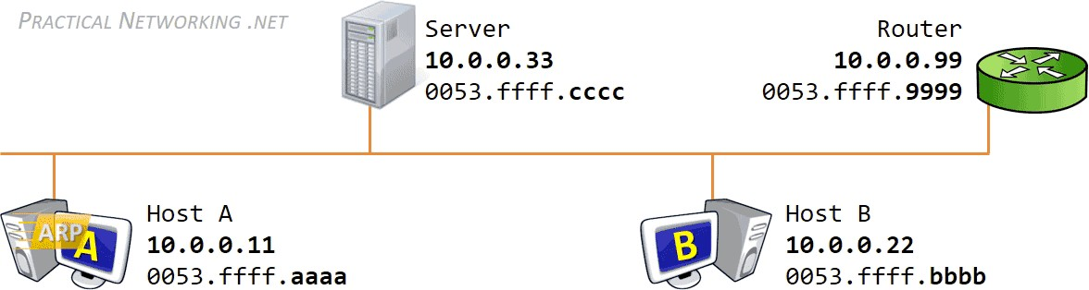
ARP Request and Reply
Summary
Bottom line:
ARP was design to map the address of one protocol (Ethernet) to the address of another protocol (IP)
NT101 – Network Security
Winter 2020

Slide 27
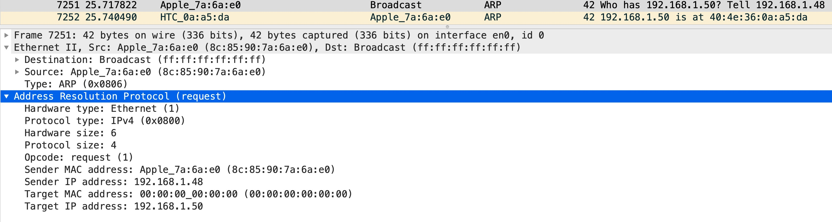
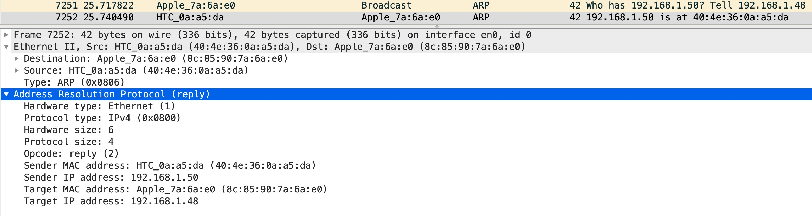
ARP Request and Reply
Example
NT101 – Network Security
Winter 2020

Slide 28
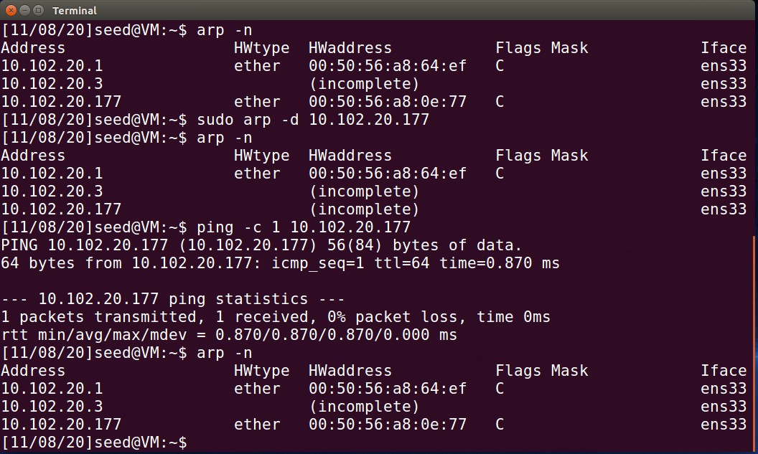
ARP Cache
aka. ARP table
ARP have a cache
→ it doesn’t need to ask MAC address every time
Linux-based system:
arp –n: show ARP cache
arp –d: del an ARP entry
NT101 – Network Security
Winter 2020
32
hoant@uit.edu.vn

Slide 29
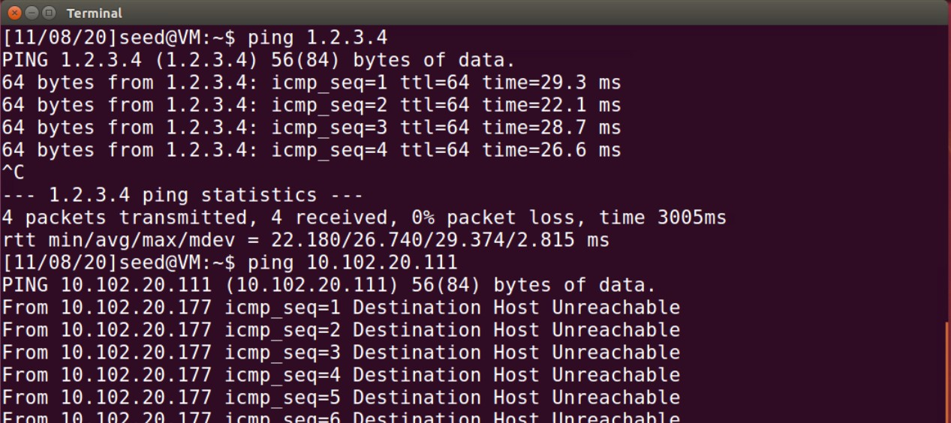
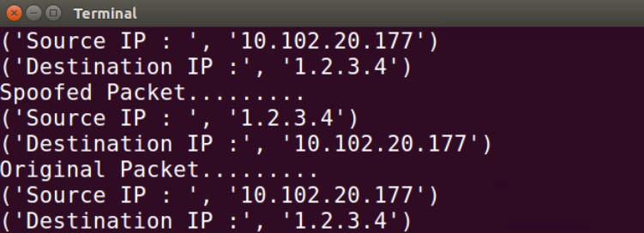
Packet sniffing issue
Homework
Task: Re-evaluate the Sniffing and Spoofing lab,
Observe the difference of the following two commands and explain your observation.
ping 1.2.3.4 (non-existing, not on the local network)
ping 10.20.20.111 (non-existing, on local network – same subnet)
Attacker (10.102.20.154)
Victim (10.102.20.177)
33

Slide 30
Outline
ARP Cache Poisoning
MAC Layer attack
NT101 – Network Security

Slide 31
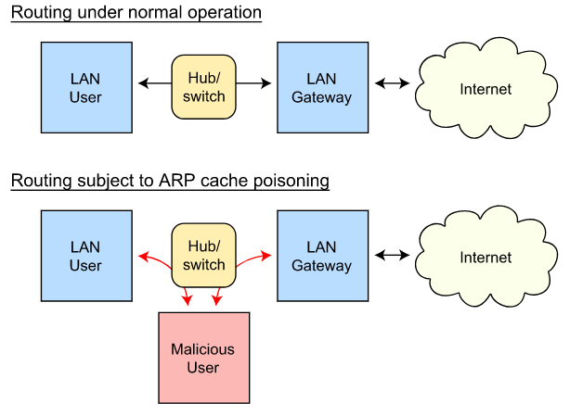
ARP Cache Poisoning
MAC Layer attack

Slide 32
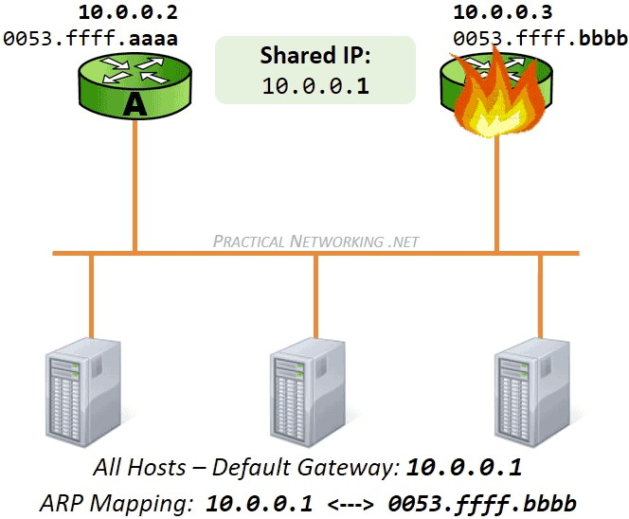
Ideas
ARP Cache Poisoning
Goal: Poisoning the cache of the ARP.
Remind: ARP is a stateless protocol
How to cause ARP to update its cache?
➔ Sending out
ARP Request
ARP Reply
ARP Gratituous
If ARP request/reply/gratitous come in ➔ ARP cache will be updated!
→ Idea: Spoofing ARP message
https://www.practicalnetworking.net/series/arp/gratuitous-arp/

Slide 33

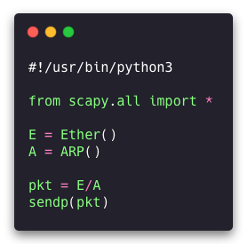
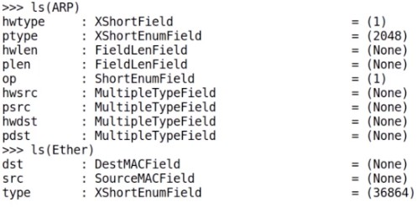
Spoofing ARP messages
Construct Ethernet frame using Scapy
Each Field of Ether and ARP Classes

Slide 34
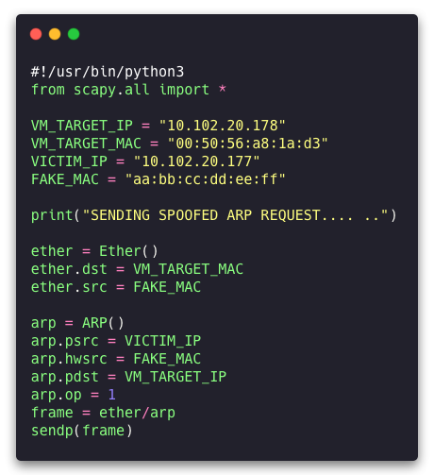
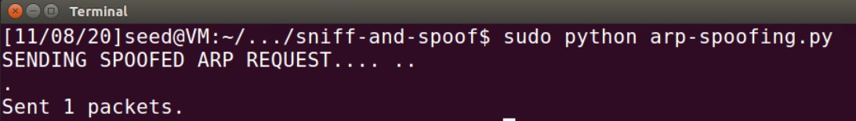
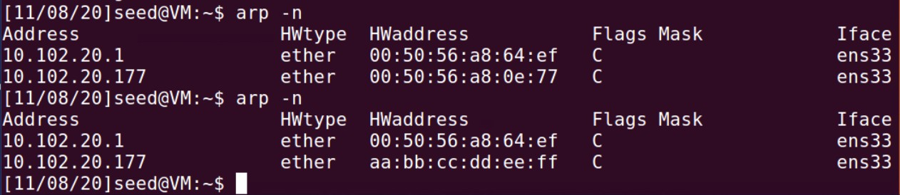
ARP Poisoning Attack code example
Spoofing ARP Request
Attacker IP: 102.102.20.154
Target: 10.102.20.178 – MAC: 00:50:56:a8:1a:d3 Victim IP: 10.102.20.177 – MAC: 00:50:56:a8:0e:77
Sending spoofed ARP request directly to Victim (Unicast)
When the receiver A receives this, it is going to see that 10.102.20.177 is mapped to this fake MAC
➔ add to ARP cache.
Before
After

Slide 35
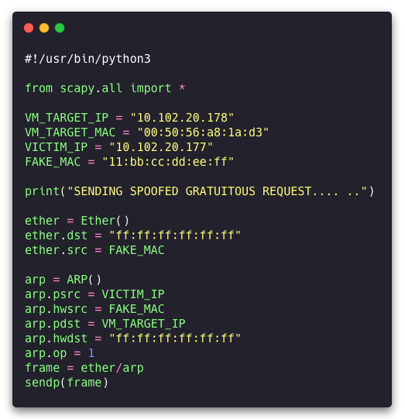
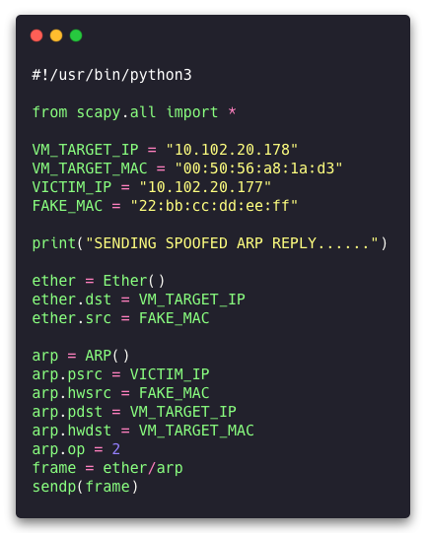
ARP Poisoning Attack code example
Spoofing ARP Gratuitous and Reply
ARP Reply
ARP Gratuitous

Slide 36
Observation
A follow-up question
For the ARP request, it doesn't matter whether the entry is in there or not, the target will automatically accept the spoofed request.
But, for the ARP reply and the ARP gratuitous messages, either this is going to be the response to a request, or there's already an entry in the cache.
What if it doesn't have? (if you're not allowed to send the request, you can only send the reply)
Idea: Get the target to put a Valid entry in its cache
→ Trigger the target to talk to the victim: Send a spoofed echo request to the target
(pretending to be the victim)
→ the target is going to reply to the victim = it need to know the victim’s MAC address!

Slide 37

MITM Attacks
using ARP Cache Poisoning
NT101 – Network Security

Slide 38



Remind: Man-in-the-middle attack
Diffie-Hellman key exchange
Share a prime number p and g < p (g is a primmitive root of p)
a
A ← gª mod p
b
g^{b} mod p → B
A
B
M
M
K_{A} ←Mª mod p = g^{ma} mod p
Micheal
m
K ←M^{b} mod p = g^{mb} mod p
B
Bob
Alice
M ← g^{m} mod p
K₁ = A^{m} mod p = g^{am} mod p = K_{A}
K₂ = B^{m} mod p = g^{bm} mod p = K_{B}
E(K_{A}, M)
D(K_{A}, M)
E(K_{B}, M)
D(K_{B}, M)
I love you
» M m
: + (
I love you
I hate you
x * #
@ $ (
I hate you

Slide 39
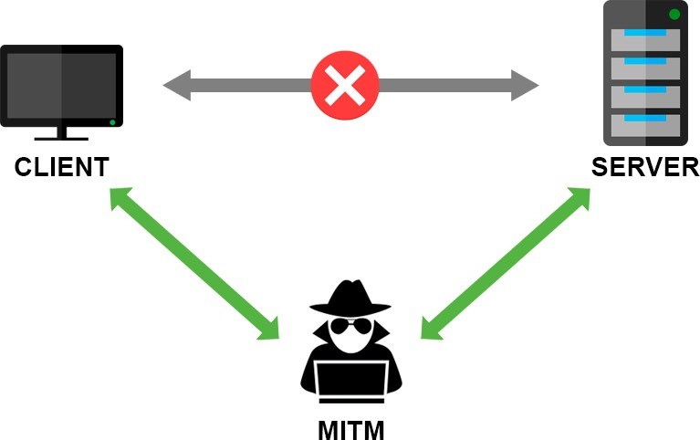

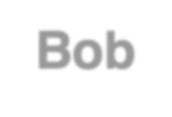

Main-in-the-Middle (MITM) Attack
General idea
Alice
Bob
What if you (attacker) are not in the middle?
→ You need to be able to redirect traffic
Link layer: ARP cache Poisoning
Network layer: ICMP Redirect
Application layer: DNS cache poisoning
(will be discussed later on)
Micheal
(can see or modify)

Slide 40






Main-in-the-Middle (MITM) Attack (cont.)
Using ARP cache poisoning
Attack idea:
M has to be on the same network as A and B
➔ try to cache poison A and B’s cache
Alice
Bob
ARP table
IP: IP B
ARP table
IP: IP A
MAC: MAC B
MAC: MAC A
Micheal
(can see or modify)

Slide 41


Main-in-the-Middle (MITM) Attack (cont.)
Using ARP cache poisoning
Attack idea:
M has to be on the same network as A and B
➔ try to cache poison A and B’s cache
Alice
Bob
ARP table
IP: IP B
MAC: MAC B
→ MAC M
ARP table
IP: IP A
MAC: MAC A
→ MAC M
When A is sending a packet to B
IP header is still: IP A → IP B
MAC address: MAC A → MAC M
→ B can still get A’s packet but will drop it!
MAC M
MAC M
Micheal
(can see or modify)
What’s going to happen when that frame arrives at M?

Slide 42





Main-in-the-Middle (MITM) Attack (cont.)
Using ARP cache poisoning
When that frame arrives at M:
dstIP = IP B
DHCP
UDP
IP
Eth
Phy
Alice
Bob
M
ARP table
IP: IP B
MAC: MAC B
→ MAC M
ARP table
IP: IP A
MAC: MAC A
→ MAC M
➔ 2 scenarios:
MAC M
MAC M
If M is configured as a router
→ Relay that packet to B
If M is configured as a hosts
→ Drop the packet
Micheal
(can see or modify)
So, what we need to do next?

Slide 43
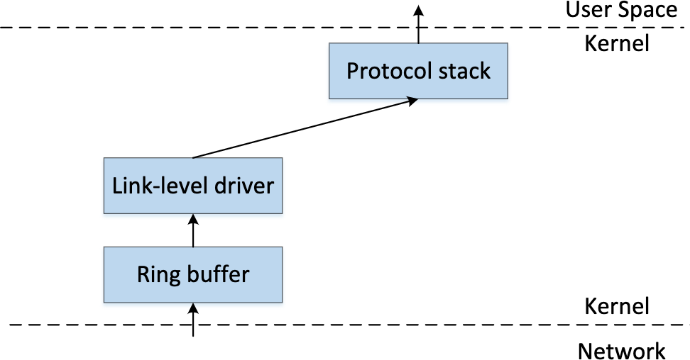
Recall: How to get a copy of packet?
Raw socket
Let the kernel know that you are a sniffer program!
→ Opening Raw socket (tell the kernel: “before you drop them, give me a copy!”)
Raw Socket

Slide 44
Main-in-the-Middle (MITM) Attack
Using ARP cache poisoning
Then, make some changes and send it out!
Alice
Bob
ARP table
IP: IP B
MAC: MAC B
→ MAC M
ARP table
IP: IP A
MAC: MAC A
→ MAC M
MAC M
MAC M
➔ B gets the modified packet!
Micheal
(can see or modify)
IP Forwarding = 0

Slide 45
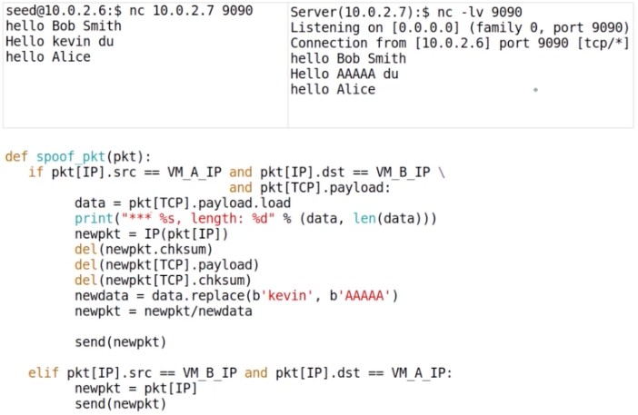
ARP MITM Attack on netcat
Example
Remove checksums
➔ Scapy will recalculate them
Intercept and replace all
’kevin’ word with ‘AAAAA’

Slide 46
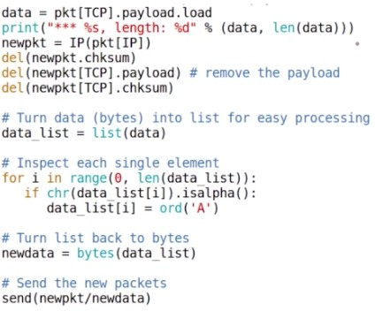
ARP MITM Attack on Telnet
Example
Recall:
The way how the telnet works is different from netcat.
Netcat: whatever you type, before you hit the return, everything in the same line will be sent in one TCP
packet.
Telnet: Every time you type a character, that character will be sent out, usually in one single TCP packet, and the server will echo this back. That's how the character you type gets displayed on the client side. It does not
display immediately every time you type; it really takes a round trip and display.
Replace all alphabet character (only) with A

Slide 47

Question: ARP Cache Poisoning
Disclaimer: this is a fiction!
In the 2020 State of Union address, President Trump said the following:
“ In 2019, the Russia hackers launched many ARP cache poisoning attacks from Russia against the computer network inside the White House, but I can probably tell you, under my leadership, we have successfully defeated all of these attacks.”
And then he paused. He looked at the audience and waiting for applause.
Do you applaud or not?

Slide 48
Question: ARP Cache Poisoning
Disclaimer: this is a fiction!
In the 2020 State of Union address, President Trump said the following:
“ In 2019, the Russia hackers launched many ARP cache poisoning attacks from Russia against the computer network inside the White House, but I can probably tell you, under my leadership, we have successfully defeated all of these attacks.”
And then he paused. He looked at the audience and waiting for applause.
Do you applaud or not?
Bottom line: You have to be inside network to be able to launch ARP Cache Poisoning attack.
➔ it's not that significant attack.

Slide 49
Countermeasures
What is the best countermeasure against MITM attacks?
Now: a lot of communications are encrypted.
Once it's encrypted, even though you can still launch the cache poisoning attack, the man-in-the- middle attack will not be successful, because you won't be able to modify the traffic.
➔ The only thing you can do is to denial of service.
➔ Encryption is the best countermeasure against most of the man-in-the-middle attacks.

Slide 50
Summary
What have we learned?
Ethernet frame and MAC header
MAC address and ARP protocol
ARP cache poisoning attack
MITM attacks using ARP cache poisoning

Slide 51

Homework
Lab exercise
ARP Cache Poisoning Attack Lab (Link)
The objective of this lab is for students to gain the first-hand experience on the ARP cache poisoning attack and learn what damages can be caused by such an attack.
In particular, students will use the ARP attack to launch a man-in-the- middle attack, where the attacker can intercept and modify the packets between the two victims A and B.
Working in a team (your final-project team) or individually.

Slide 52

For next time…
Looking ahead
Ready for next class:
Tentative topic: Network Layer: IP, ICMP and Attacks
Reading and practicing (in advance):
SEED book, Chapter 15 - 17
Refs: https://www.handsonsecurity.net/resources.html
SEED Lab: IP and ICMP Attacks Lab
Refs: https://seedsecuritylabs.org/Labs_16.04/Networking/IP_Attacks/

Slide 53

Today end,
Congrats!

